Slide 1
SBOL Extensions
SBOL Workshop, Nov. 7-8, BU
Mandy Wilson

Slide 2
SBOL Core
Status: Fairly stable, entering maintenance mode
Minimal dataset
Some say “too minimal”
Looking to SBOL Extensions to extend dataset.

Slide 3
SBOL Extension Working Groups
Working Group Hierarchy
WG Leader
WG Team
SBOL Editor as WG Liaison
Responsibilities:
WG Develops the specification
Extends libSBOL code base (?)
Maintain SBOL Extension page on the website

Slide 4
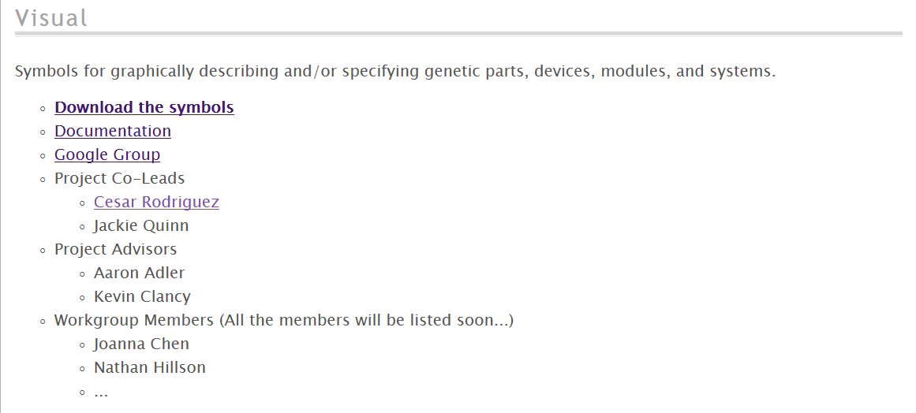
Website Presence

Slide 5
SBOL Visual
Most publicized extension (and probably the most adopted)
Website includes:
Downloadable icons
Links to specifications
Link to the GoogleGroup
Link to Github
Overall, a good layout to work toward.

Slide 6
Don’t Wait
Publicity is better
Encourages early adoption
More early input = less radical changes later
Many hands make light work
… and many other clichés to prove my point.
Progress on Extensions will lead to SBOL adoption.

Slide 7
SBOL Extension Presentations
Extension Serialization [Michal]
Visual [Jackie & Cesar]
Review of SBOL Visual Adoption
Method for approving symbols
Method for managing the non-SO identifiers
Depiction of regulation
Use cases for the DNA construction symbols
Modeling [Matthew]
Host Context [Michal / Bryan]
Performance [Michal]
New Extension Ideas
Protein (& Chassis) Extension?
Regulatory Interactions? [Ernst]
DNA - mRNA - Protein Extension? [Raik]

